Slide 1
BDS Chapter 9:
Working with Range Data

Slide 2
Genomic Ranges and Coordinate Systems
Here is a problem related to yours and solved before. Could you use it? Could you use its result? Could you use its method?
— How to Solve It George Pólya (1945)

Slide 3
Why do we care?
DNA, in chromosomes/contigs/plasmids/etc, is organized in sequences
As,Ts,Gs, and Cs act as our coordinate system for a genome
Genomic data can be represented as ranges, linking them to regions on a chromosome

Slide 4
Genomic Range (Interval)
Genomic Range: integer intervals that represent a subsequence of consecutive positions on a sequence like a chromosome
Chromosome Name: aka sequence name, named like “chr1”, “chrX”, “MT” for mitochondrial
Range: composed of a start and stop position
Strand: forward (positive) or reverse (negative) strand of DNA; many protein coding exons are specific to strand
These ranges are specific to their reference genomes, completely linked to them
Notes:
Sense: where positive and negative come from, used to indicate polarity with respect to protein transcription
Positive Strand: when a RNA version of the same sequence is translatable into a protein
Negative Strand: the complement to the positive strand, is what actually makes the mRNA and gets translated into a protein

Slide 5
0 and 1-Based Formats
0-Based Formats:
BED, BAM, BCF
Python uses this type of indexing
1-Based Formats:
GTF, GFF, SAM, VCF, Wiggle, GenomicRanges, BLAST, GeneBank
R uses this type of indexing

Slide 6
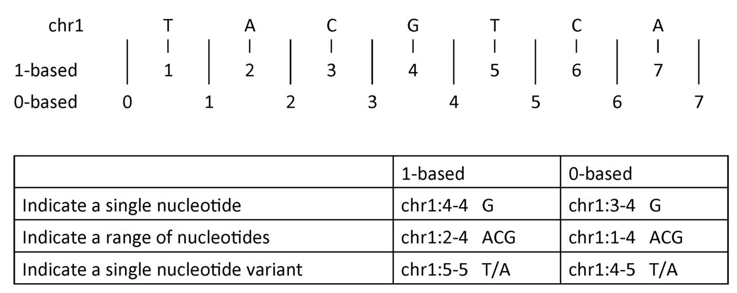
Cheatsheet
Notes:
Source: https://www.biostars.org/p/84686/

Slide 7
Mind Your Strand
Most formats give range coordinates from the forward strand
But protein coding regions can be on either strand
If given Forward:
the nucleotide sequence underlying this range is the mRNA created during transcription
If given Reverse:
the reverse complement of the nucleotide sequence is the mRNA sequence created during transcription

Slide 8
Bioconductor Packages
Open-source software utilizing R for high-throughput data
Updates along with R
Has lots of potentially useful features for manipulating your data sets

Slide 9
Installing Bioconductor
Open RStudio, or R
source("http://bioconductor.org/biocLite.R")
biocLite(“GenomicRanges”)
library(IRanges)
This should load the necessary packages for this chapter
If you want more, use library(BiocInstaller)

Slide 10
Storing Ranges with IRanges
Must specify a start and end position, store in a variable
> rng <- IRanges(start=4, end=13)
> rng
IRanges of length 1 start end width
[1] 4 13 10
Is 1-based and uses closed intervals to be consistent with R

Slide 11
Storing Ranges with IRanges
IRanges() can take arguments like width as well
IRanges(start=4, width=3)
IRanges(end=5, width=5)
Can take vector arguments to create an object with many ranges
x <- IRanges(start=c(4, 7, 2, 20), end=c(13, 7, 5, 23))
Assign names to your ranges:
names(x) <- letters[1:4]

Slide 12
Storing Ranges with IRanges
Take a look at the beginning, end, width:
start(x)
end(x)
width(x)
These will return the respective values for each of the ranges within the IRanges object
range(x)will give the span of ranges within the IRanges object
Subset an IRange just like any other R object
X[2:3]
X['a']
Combine ranges using the function c()

Slide 13
Moral of the Story....
Bioconductor offers lots of tools
GRanges
findOverlaps
IntervalTree
etc.
But it would take me 5+ hours to explain them all

Slide 14
So… on to BEDTools!
What is it?
Is a single command with many subcommands
Is used in the command line of a unix shell to work directly with data
Works with plain-text range formats, so it collaborates with Unix tools
Is used in a very similar way to Bioconductor commands

Slide 15
About BEDTools
What are the advantages of using BEDTools?
Don’t have to load data into memory
More convenient to work within the command line for simpler tasks
GenomicRanges is more work-intensive, requires writing scripts
Can be “parallelized” (in chapter 12)
Disadvantages?
Not very fine-tuned
Less flexible solutions compared to GenomicRanges

